Slide 1
HOSTEL MANAGEMENT SYSTEM

Slide 2
INTRODUCTION TO HMS
A Hostel Management System is a software application designed to automate the administrative tasks involved in managing a hostel.
It is an efficient way to store information about the tenants, room availability, payments so on all the other management related things.
It not only provides us with an efficient way to store but also better way to retrieve the data whenever needed.
DBMS plays a crucial role in HMS by providing structured framework for the storage of various types of data.

Slide 3
FUNCTIONALITIES OF HMS
MAINTAINING RECORDS OF THE NEW AND ALREADY EXISTING TENANTS
INSERTING RECORDS OF NEW TENANTS
DELETING RECORDS OF UNNECCESSARY TENANTS
UPDATING RECORDS OF TENANTS AS REQUIRED
SEARCHING RECORDS OF A SPECIFIC TENANT
VIEWING RECORDS OF ALL TENANTS
ACCESSING AND QUERYING THE RECORDS EFFICIENTLY

Slide 4
TABLES INVOLVED IN HMS
CREATE TABLE Resident(
ID INT NOT NULL PRIMARY AUTO_INCREMENT,
Name VARCHAR(50)NOT NULL,
DOB DATE NOT NULL,
Age INT NOT NULL,
Gender ENUM(‘M’, ’F’, ’O’)NOT NULL,
Contact_Number BIGINT(10)NOT NULL,
Email_ID VARCHAR(70)
);
CREATE TABLE Guardian(
Resident_ID INT NOT NULL PRIMARY KEY,
Name VARCHAR(50)NOT NULL,
Relation VARCHAR(20)NOT NULL,
Contact_Number BIGINT(10)NOT NULL,
Email_ID VARCHAR(70),
Address VARCHAR(150)NOT NULL,
FOREIGN KEY Resident_ID REFERENCES Resident(ID)
);

Slide 5
CREATE TABLE Rent(
Resident_ID INT NOT NULL PRIMARY KEY,
Plan ENUM(‘Annually’, ’Half-Yearly’, ’Quarterly’, ’Monthly’)NOT NULL,
Amount INT NOT NULL,
Payment_Date DATE NOT NULL,
Payment_Mode ENUM(‘Online’, ’Offline’)NOT NULL,
FOREIGN KEY(Resident_ID)REFERENCES Resident(ID)
);
CREATE TABLE Room(
Resident_ID INT NOT NULL PRIMARY KEY,
Room_Number ENUM('1’, '2’, '3’, '4',’ 5')NOT NULL,
Floor ENUM(‘First Floor’, ’Second Floor’, ’Third Floor’, ’Fourth Floor’)NOT NULL,
Block ENUM(‘Block-1’, ’Block-2’, ’Block-3’)NOT NULL,
FOREIGN KEY(Resident_ID)REFERENCES Resident(ID)
);
CREATE TABLE Work(
Resident_ID INT NOT NULL PRIMARY KEY,
Company_Name VARCHAR(50)NOT NULL,
Company_Address VARCHAR(150)NOT NULL,
Company_Number BIGINT(10),
Designation ENUM(‘Student’, ’Employee’)NOT NULL,
FOREIGN KEY(Resident_ID)REFERENCES Resident(ID)
);

Slide 6
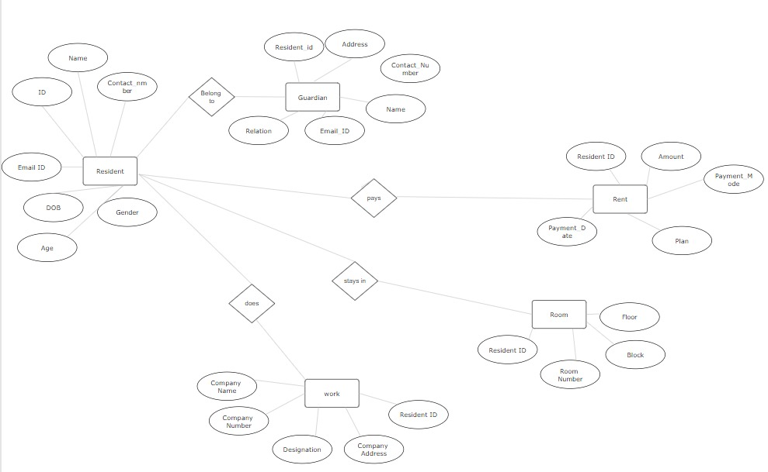
ER DIAGRAM

Slide 7
NORMALISATION
Normalization is a series of tests that individual relational schemas go through to ensure that the database is normalized to avoid redundancy as much as possible. It is a process of organizing data in database.
Normalization plays a crucial role in the designing of efficient(GOOD) database schemas. It is in three forms
1). FIRST NORMAL FORM (1NF):
It is the test of the normalization process.
It ensures that the there are no multi-valued Attributes.
To Qualify this test, all columns should be atomic in nature(i.e.., No groups or arrays of attributes)
As we’ve seen before, there are no multi-valued attributes in the relations of our Database Schema. So it passes 1NF test.

Slide 8
2). SECOND NORMAL FORM (2NF):
It is the second test in the normalization process. It ensures that the relation has no partial dependency.
Partial dependency is functional dependency condition in which, despite the removal an attribute from Y, the FD Y->X holds. In other words, it is a condition in which a non-prime attribute depends on some prime attributes only, instead of depending on all prime attributes.
In our database schema, as all the relations have exactly one prime attribute, It passed 2NF test too.
3). THIRD NORMAL FORM (3NF):
It is the third test in the normalization process. It ensures that the relation has no transitive dependency.

Slide 9
Transitive Dependency is a functional dependency condition in which any two non-prime attributes involve in a functional dependency relationship.
In all the relations of the database schema, same kind of functional relationship can be observed
i.e.., Y->X where Y is a single attribute which is the ID(primary key) and X is the set of all other attributes.
So this database schema passed 3NF test too.
With this, it marks the successful normalization process of the database schema.

Slide 10
THANK YOU…
BY GROUP–H:
AP22110011361 – G. Hema Priya
AP22110011362 – R. Yogesh
AP22110011363 – O. Keerthan
AP22110011364 – G. V. Sai. Kousik
AP22110011365 – V. Koushik Babu

